Slide 1
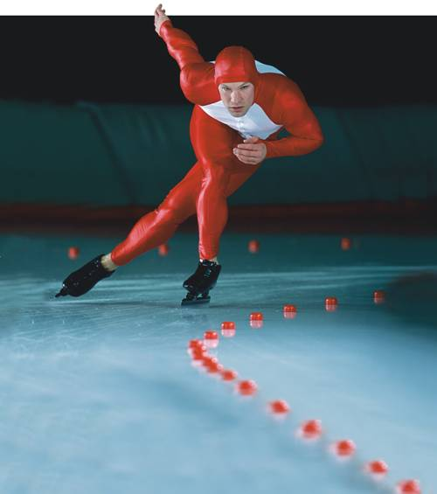
36–1 The Skeletal System
Notes:
Photo Credit: © Getty Images

Slide 2
The Skeleton
The skeleton:
supports the body.
protects internal organs.
provides for movement.
stores mineral reserves.
provides a site for blood cell formation.

Slide 3
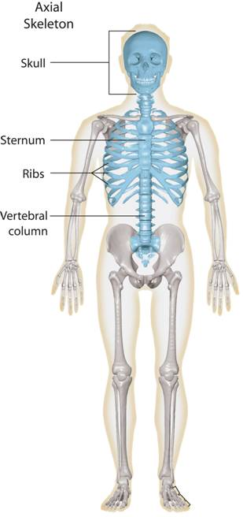
The Skeleton
Skull
The axial skeleton (blue) supports the central axis of the body.
Sternum
Ribs
Vertebral column
Axial Skeleton
Notes:
The skeleton supports the body. The human skeleton is divided into two parts: the axial skeleton and the appendicular skeleton.

Slide 4
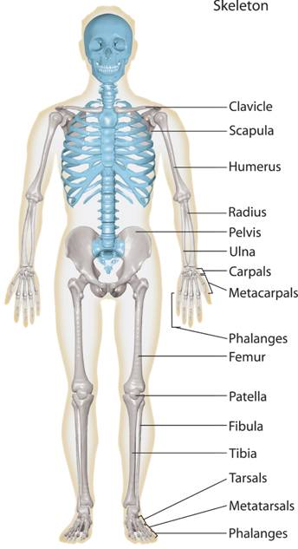
The Skeleton
The bones of the arms and legs, along with the bones of the pelvis and shoulder area form the appendicular skeleton (grey).
Clavicle
Scapula
Humerus
Radius
Pelvis
Ulna
Carpals
Metacarpals
Phalanges
Femur
Patella
Fibula
Tibia
Tarsals
Appendicular Skeleton
Metatarsals
Phalanges
Notes:
The skeleton supports the body. The human skeleton is divided into two parts: the axial skeleton and the appendicular skeleton.

Slide 5
Structure of Bones
Bones are a solid network of living cells and protein fibers that are surrounded by deposits of calcium salts.

Slide 6
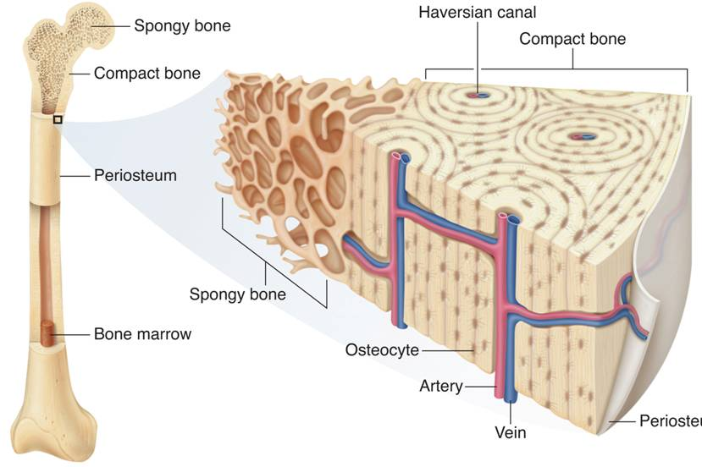
Structure of Bones
Spongy bone
Haversian canal
Compact bone
Compact bone
Periosteum
Spongy bone
Bone marrow
Osteocyte
Artery
Vein
Periosteum
Notes:
Bones are a solid network of living cells and protein fibers that are supported by deposits of calcium salts. A typical long bone such as the femur contains spongy bone and compact bone. Within compact bone are Haversian canals, which contain blood vessels.

Slide 7
Structure of Bones
Osteocytes, or mature bone cells, are embedded in the bone matrix.
Other bone cells—osteoclasts and osteoblasts—line the Haversian canals and the surfaces of compact and spongy bone.
Osteoclasts break down bone.
Osteoblasts produce bone.

Slide 8
Structure of Bones
Bone marrow is a soft tissue inside the cavities within bones.
There are two types of bone marrow:
Yellow marrow is made up of fat cells.
Red marrow produces red blood cells, some kinds of white blood cells, and platelets.

Slide 9
Development of Bones
Development of Bones
The skeleton of an embryo is composed of cartilage.
Cartilage is a strong connective tissue that supports the body and is softer and more flexible than bone.

Slide 10
Development of Bones
Cartilage is replaced by bone during the process of bone formation called ossification.
Bone tissue forms as osteoblasts secrete mineral deposits.
When the osteoblasts become surrounded by bone tissue, they mature into osteocytes.

Slide 11
Types of Joints
Types of Joints
A place where one bone attaches to another bone is called a joint.
Joints permit bones to move without damaging each other.

Slide 12
Types of Joints
Depending on its type of movement, a joint is classified as immovable, slightly movable, or freely movable.

Slide 13
Types of Joints
Immovable Joints
Immovable joints, called fixed joints, allow no movement.
The bones are interlocked and held together by connective tissue, or they are fused together.
Places where bones in the skull meet are examples of immovable joints.

Slide 14
Types of Joints
Slightly Movable Joints
Slightly movable joints permit a small amount of restricted movement.
Slightly movable joints are found in the joints between adjacent vertebrae.

Slide 15
Types of Joints
Freely Movable Joints
Freely movable joints permit movement in one or more directions.
Four common freely movable joints are:
ball-and-socket joints
hinge joints
pivot joints
saddle joints

Slide 16
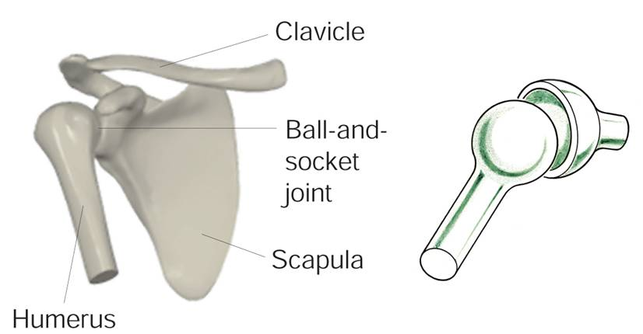
Types of Joints
Ball-and-socket joints permit movement in many directions.
Notes:
The shoulder joint has a ball-and-socket joint.

Slide 17
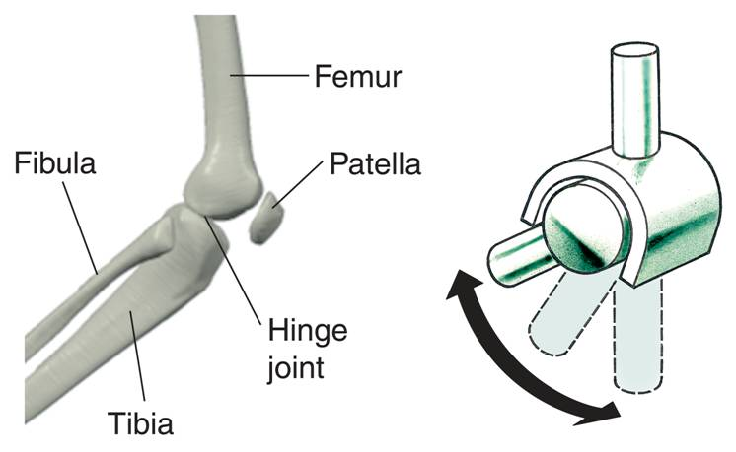
Types of Joints
Hinge joints permit back-and-forth motion.
Notes:
The knee is a hinge joint.,

Slide 18
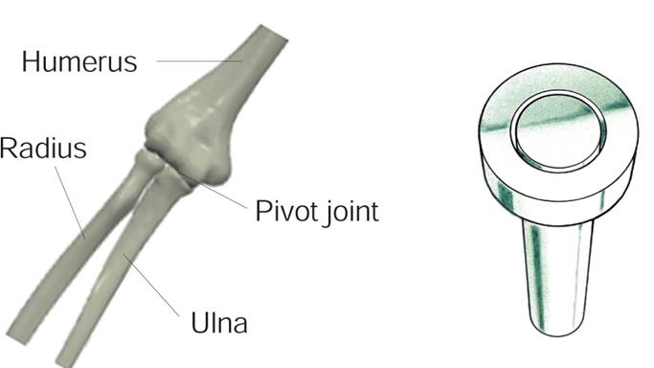
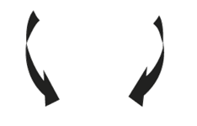
Types of Joints
Pivot joints allow one bone to rotate around another.
Notes:
The elbow has a pivot joint.

Slide 19
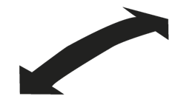
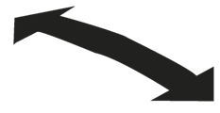
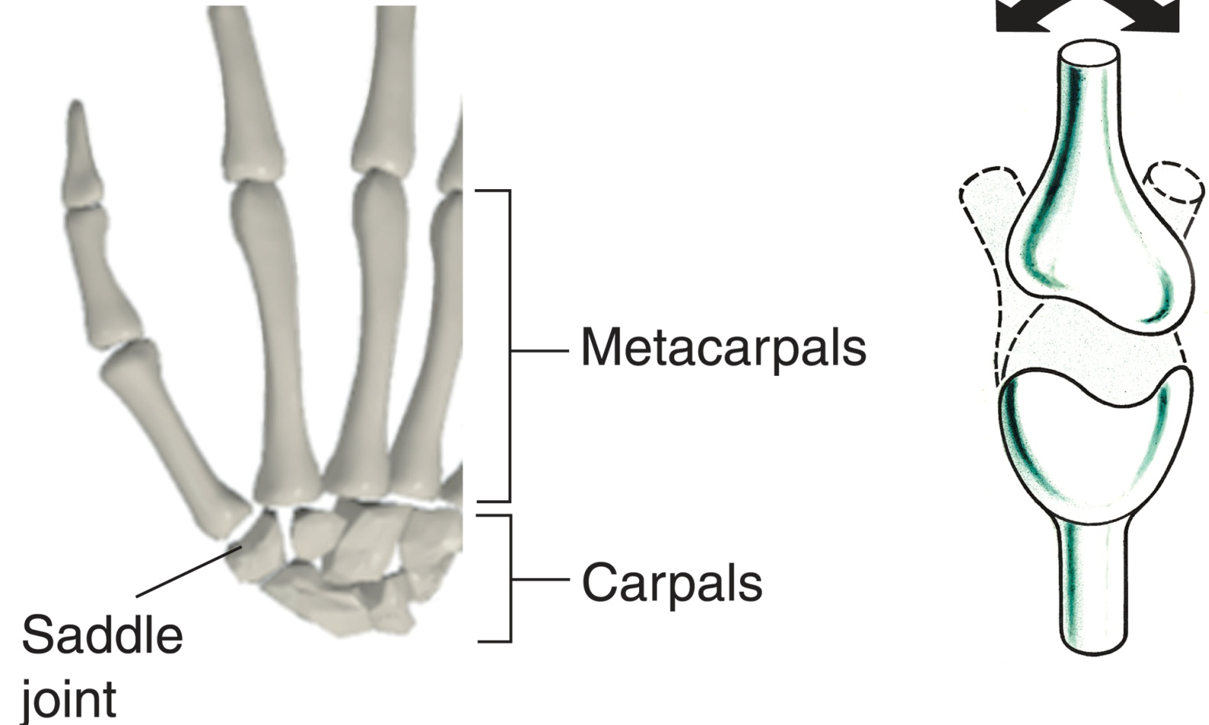
Types of Joints
Saddle joints permit one bone to slide in two directions.
Notes:
The joint at the base of your thumb is a saddle joint.

Slide 20
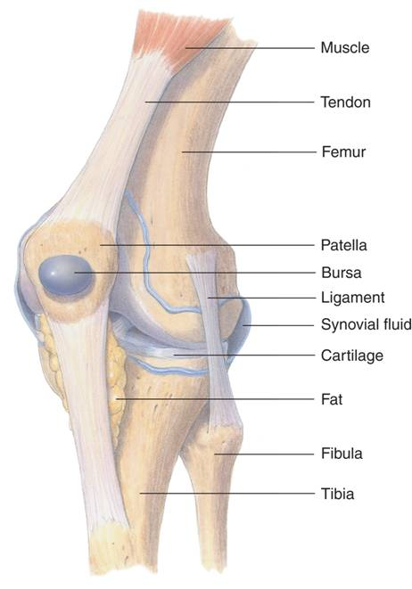
Structure of Joints
Muscle
Knee Joint
Tendon
Femur
Patella
Bursa
Ligament
Synovial fluid
Cartilage
Fat
Fibula
Tibia
Notes:
The knee joint is protected by cartilage and bursae. The ligaments hold the bones composing the knee joint—femur, patella, tibia, and fibula—together.

Slide 21
Structure of Joints
Connective tissue called ligaments hold bones together in joints and are attached to membranes that surround bones.
Synovial fluid forms a thin lubricating film over the surface of the joint.
Synovial fluid enables the bones to slide past each other more smoothly.

Slide 22
Skeletal System Disorders
Skeletal System Disorders
Excessive strain on a joint may produce inflammation, in which excess fluid causes swelling, pain, heat, and redness.
Inflammation of a bursa is called bursitis.
Inflammation of the joint itself is called arthritis.
Another skeletal system disorder is osteoporosis. Osteoporosis is caused by a loss of calcium in the bone.

Slide 23
36–1

Slide 24
36–1
Red blood cells, some kinds of white blood cells, and platelets are produced by
red marrow.
cartilage.
yellow marrow.
osteocytes.

Slide 25
36–1
Mature bone cells are called
periosteum.
osteocytes.
bone marrow.
Haversian canals.

Slide 26
36–1
In freely movable joints, what covers the surfaces where the two bones come together?
ligaments
cartilage
bursae
tendons

Slide 27
36–1
During ossification, cartilage is replaced by
bone.
ligament.
marrow.
tendon.

Slide 28
36–1
The shoulder joint is an example of a
ball-and-socket joint.
hinge joint.
pivot joint.
saddle joint.

Slide 29
END OF SECTION

