Slide 1
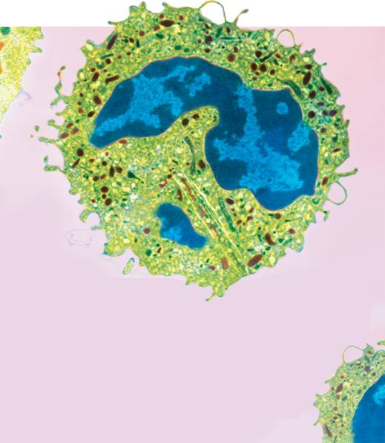
7-3 Cell Boundaries
7-3 Cell Boundaries
Notes:
Photo Credit: © Quest/Science Photo Library/Photo Researchers, Inc.

Slide 2
Cell Membrane
Cell Membrane
  The cell membrane regulates what enters and leaves the cell and also provides protection and support.

Slide 3
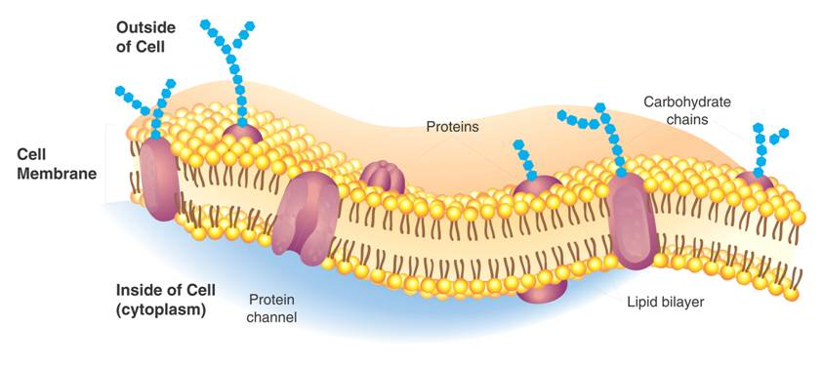
Cell Membrane
Cell Membrane
Outside of cell
Carbohydrate chains
Proteins
Cell membrane
Inside of cell (cytoplasm)
Protein channel
Lipid bilayer
Notes:
The cell membrane regulates what enters and leaves the cell.

Slide 4
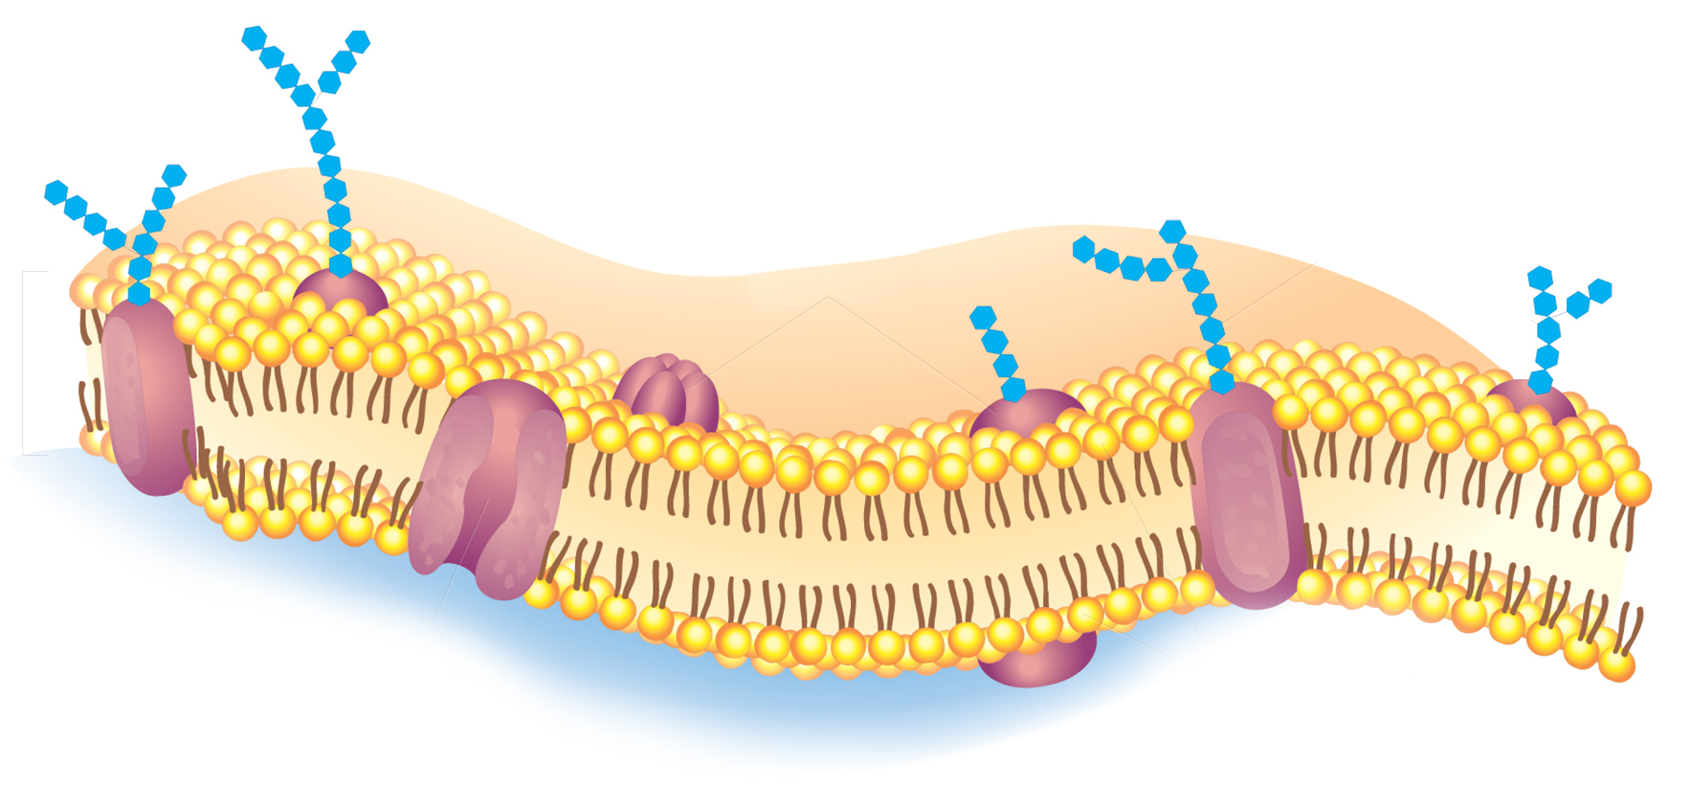
Cell Membrane
The composition of nearly all cell membranes is a double-layered sheet called a lipid bilayer.
Lipid bilayer
Notes:
The cell membrane regulates what enters and leaves the cell.

Slide 5
Cell Membrane
Most cell membranes contain protein molecules embedded in the lipid bilayer, some of which have carbohydrate molecules attached to them.
Carbohydrate chains
Proteins
Protein channel
Notes:
The cell membrane regulates what enters and leaves the cell.

Slide 6
Cell Walls
  The main function of the cell wall is to provide support and protection for the cell.

Slide 7
Cell Walls
Cell Walls
    Cell walls are found in plants, algae, fungi, and many prokaryotes.
    The cell wall lies outside the cell membrane.
    Most cell walls are porous enough to allow water, oxygen, carbon dioxide, and certain other substances to pass through easily.

Slide 8
Diffusion Through Cell Boundaries
Diffusion Through Cell Boundaries
    Every living cell exists in a liquid environment.
    The cell membrane regulates movement of dissolved molecules from the liquid on one side of the membrane to the liquid on the other side.

Slide 9
Diffusion Through Cell Boundaries
  Measuring Concentration
    A solution is a mixture of two or more substances.
    The substances dissolved in the solution are called solutes.
    The concentration of a solution is the mass of solute in a given volume of solution, or mass/volume.

Slide 10
Diffusion Through Cell Boundaries
  Diffusion
    Particles in a solution tend to move from an area where they are more concentrated to an area where they are less concentrated.
    This process is called diffusion.
    When the concentration of the solute is the same throughout a system, the system has reached equilibrium.

Slide 11
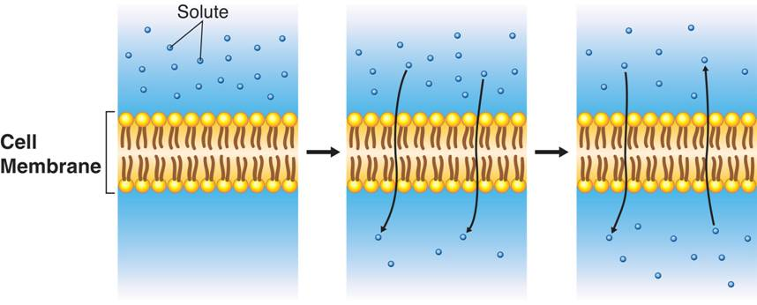
Diffusion Through Cell Boundaries
Notes:
Diffusion is the process by which molecules of a substance move from areas of higher concentration to areas of lower concentration. Diffusion does not require the cell to use energy.

Slide 12
Diffusion Through Cell Boundaries
There is a higher concentration of solute on one side of the membrane as compared to the other side of the membrane.
Notes:
Diffusion is the process by which molecules of a substance move from areas of higher concentration to areas of lower concentration. Diffusion does not require the cell to use energy.

Slide 13
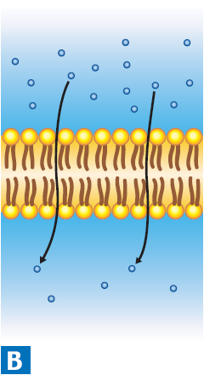
Diffusion Through Cell Boundaries
Solute particles move from the side of the membrane with a higher concentration of solute to the side of the membrane with a lower concentration of solute. The solute particles will continue to diffuse across the membrane until equilibrium is reached.
Notes:
Diffusion is the process by which molecules of a substance move from areas of higher concentration to areas of lower concentration. Diffusion does not require the cell to use energy.

Slide 14
Diffusion Through Cell Boundaries
When equilibrium is reached, solute particles continue to diffuse across the membrane in both directions.
Notes:
Diffusion is the process by which molecules of a substance move from areas of higher concentration to areas of lower concentration. Diffusion does not require the cell to use energy.

Slide 15

Diffusion Through Cell Boundaries
  Diffusion depends upon random particle movements. Therefore, substances diffuse across membranes without requiring the cell to use energy.

Slide 16
Osmosis
  What is osmosis?

Slide 17
Osmosis
Osmosis
  Osmosis is the diffusion of water through a selectively permeable membrane.

Slide 18
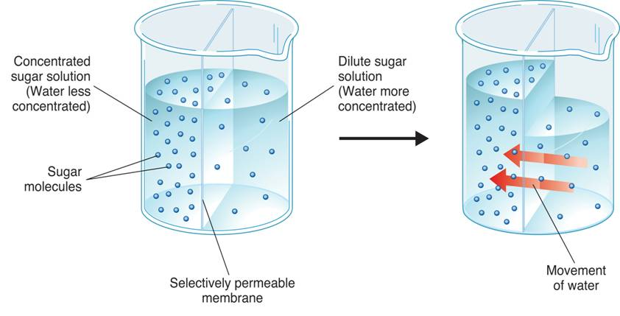
Osmosis
  How Osmosis Works
Concentrated sugar solution (Water less concentrated)
Dilute sugar solution (Water more concentrated)
Sugar molecules
Movement of water
Selectively permeable membrane
Notes:
Osmosis is the diffusion of water through a selectively permeable membrane. In the first beaker, water is more concentrated on the right side of the membrane. As a result, the water diffuses (as shown in the second beaker) to the area of lower concentration.

Slide 19
Osmosis
Water tends to diffuse from a highly concentrated region to a less concentrated region.
If you compare two solutions, the more concentrated solution is hypertonic (“above strength”).
The more dilute solution is hypotonic (“below strength”).

Slide 20
Osmosis
When concentrations of solutions are the same on both sides of a membrane, the solutions are isotonic (“same strength”).

Slide 21
Osmosis
  Osmotic Pressure
    Osmosis exerts a pressure known as osmotic pressure on the hypertonic side of a selectively permeable membrane.

Slide 22
Osmosis
Because the cell is filled with salts, sugars, proteins, and other molecules, it will almost always be hypertonic to fresh water.
If so, the osmotic pressure should produce a net movement of water into the cell. As a result, the volume of the cell will increase until the cell becomes swollen or bursts.

Slide 23
Osmosis
Cells in large organisms are not in danger of bursting because they are bathed in fluids, such as blood, that are isotonic.
Other cells are surrounded by tough cell walls that prevent the cells from expanding even under tremendous osmotic pressure.

Slide 24
Facilitated Diffusion
Facilitated Diffusion
    Cell membranes have protein channels that act as carriers, making it easy for certain molecules to cross.

Slide 25
Facilitated Diffusion
The movement of specific molecules across cell membranes through protein channels is known as facilitated diffusion.
Hundreds of different protein channels have been found that allow particular substances to cross different membranes.

Slide 26
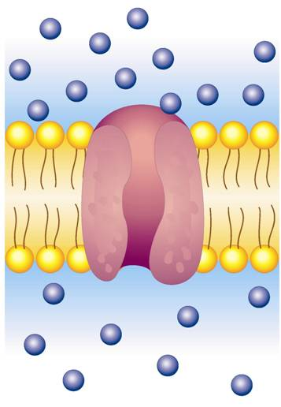

Facilitated Diffusion
Glucose molecules
Facilitated Diffusion
Protein channel
Notes:
During facilitated diffusion, molecules, such as glucose, that cannot diffuse across the cell membrane’s lipid bilayer on their own move through protein channels instead.

Slide 27
Facilitated Diffusion
Although facilitated diffusion is fast and specific, it is still diffusion.
Therefore, facilitated diffusion will only occur if there is a higher concentration of the particular molecules on one side of a cell membrane as compared to the other side.

Slide 28
Active Transport
Active Transport
    Sometimes cells move materials in the opposite direction from which the materials would normally move—that is against a concentration difference. This process is known as active transport.
    Active transport requires energy.

Slide 29
Active Transport
  Molecular Transport
    In active transport, small molecules and ions are carried across membranes by proteins in the membrane.
    Energy use in these systems enables cells to concentrate substances in a particular location, even when diffusion might move them in the opposite direction.

Slide 30
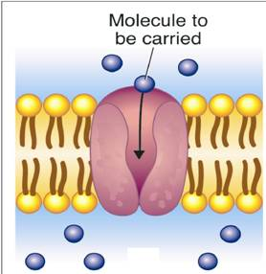
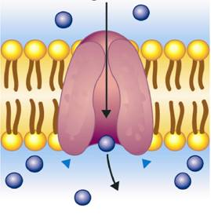

Active Transport
Molecule to be carried
    Active Transport
Notes:
Active transport of particles against a concentration difference requires transport proteins and energy.

Slide 31
Active Transport
  Endocytosis and Exocytosis
    Large molecules and even solid clumps of material may undergo active transport by means of the cell membrane.
    Endocytosis is the process of taking material into the cell by means of infoldings, or pockets, of the cell membrane.
    The pocket breaks loose from the outer portion of the cell membrane and forms a vacuole within the cytoplasm.

Slide 32
Active Transport
    Two examples of endocytosis are:
      phagocytosis
      pinocytosis

Slide 33
Active Transport
In phagocytosis, extensions of cytoplasm surround a particle and package it within a food vacuole. The cell then engulfs it.
Phagocytosis requires a considerable amount of energy.

Slide 34
Active Transport
In pinocytosis, tiny pockets form along the cell membrane, fill with liquid, and pinch off to form vacuoles within the cell.

Slide 35
Active Transport
  Exocytosis
    Many cells also release large amounts of material from the cell, in a process called exocytosis.
    During exocytosis, the membrane of the vacuole surrounding the material fuses with the cell membrane, forcing the contents out of the cell.

Slide 36
7-3

Slide 37


7-3
  Unlike a cell wall, a cell membrane
    is composed of a lipid bilayer.
    provides rigid support for the surrounding cell.
    allows most small molecules and ions to pass through easily.
    is found only in plants, fungi, algae, and many prokaryotes.

Slide 38

7-3
  The concentration of a solution is defined as the
    volume of solute in a given mass of solution.
    mass of solute in a given volume of solution.
    mass of solution in a given volume of solute.
    volume of solution in a given mass of solute.

Slide 39

7-3
  If a substance is more highly concentrated outside the cell than inside the cell and the substance can move through the cell membrane, the substance will
    move by diffusion from inside the cell to outside.
    remain in high concentration outside the cell.
    move by diffusion from outside to inside the cell.
    cause water to enter the cell by osmosis.

Slide 40

7-3
  The movement of materials in a cell against a concentration difference is called
    facilitated diffusion.
    active transport.
    osmosis.
    diffusion.

Slide 41

7-3
  The process by which molecules diffuse across a membrane through protein channels is called
    active transport.
    endocytosis.
    facilitated diffusion.
    osmosis.

Slide 42
END OF SECTION

