Slide 1
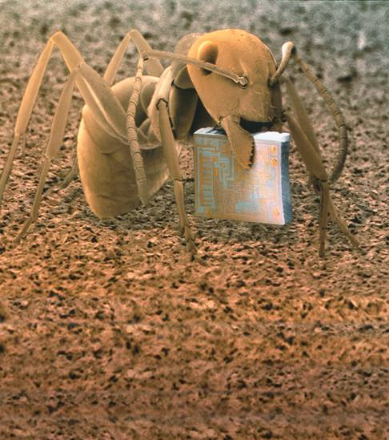
1-1 What Is Science?
Notes:
Photo Credit: © Andrew Syred/Science Photo Library/Photo Researchers, Inc.

Slide 2
Thinking Like a Scientist
Thinking Like a Scientist
Scientific thinking begins with observation.
Observation is the process of gathering information about events or processes in a careful, orderly way.

Slide 3
Thinking Like a Scientist
The information gathered from observations is called data.
Quantitative data are expressed as numbers, obtained by counting or measuring.
Qualitative data are descriptive and involve characteristics that can’t easily be measured.

Slide 4
Thinking Like a Scientist
Scientists use data to make inferences.
An inference is a logical interpretation based on prior knowledge or experience.

Slide 5
Explaining and Interpreting Evidence
Explaining and Interpreting Evidence
A hypothesis is a proposed scientific explanation for a set of observations.
A hypothesis may be ruled out or confirmed.

Slide 6
Explaining and Interpreting Evidence
A hypothesis must be proposed in a way that can be tested.
Hypotheses are tested by performing controlled experiments or by gathering new data.

Slide 7
Science as a Way of Knowing
Science as a Way of Knowing
Science is an ongoing process that involves:
asking questions
observing
making inferences
testing hypotheses

Slide 8
Science as a Way of Knowing
Scientific understanding is always changing.
Good scientists are skeptics who question both existing ideas and new hypotheses.

Slide 9
Science and Human Values
Science and Human Values
An understanding of science and the scientific approach is essential to making intelligent decisions.
Scientists make recommendations based on data collected through research.

Slide 10
Science and Human Values
Decisions involve many factors besides scientific information, including:
the society in which we live
economic considerations
laws
moral principles
Citizens decide what to do when they vote.

Slide 11
1–1

Slide 12
1–1
Observations involving numbers are known as
qualitative observations.
hypothetical observations.
quantitative observations.
inferred observations.

Slide 13
1–1
Which of the following shows the interaction of science and human values?
the debate over the best way to produce electricity
investigating how a manatee behaves
Determining what causes a disease
using a hypothesis to test an explanation

Slide 14
1–1
A scientist takes paint chips from 10 apartments in a large building. She tests for the presence of lead in the paint and finds it in all 10 samples. She then concludes that lead paint is probably present in all 120 apartments in the building. This conclusion is an example of
a scientific fact.
a scientific error.
proof.
a reasonable inference.

Slide 15
1–1
A possible explanation for a set of observations is known as
data.
a hypothesis.
an inference.
a result.

Slide 16
1–1
A good scientific hypothesis must be
correct.
able to be tested.
obvious.
based on common sense.

Slide 17
END OF SECTION

