Slide 1
Notes#4 Practice Test Curve Sketching

Slide 2
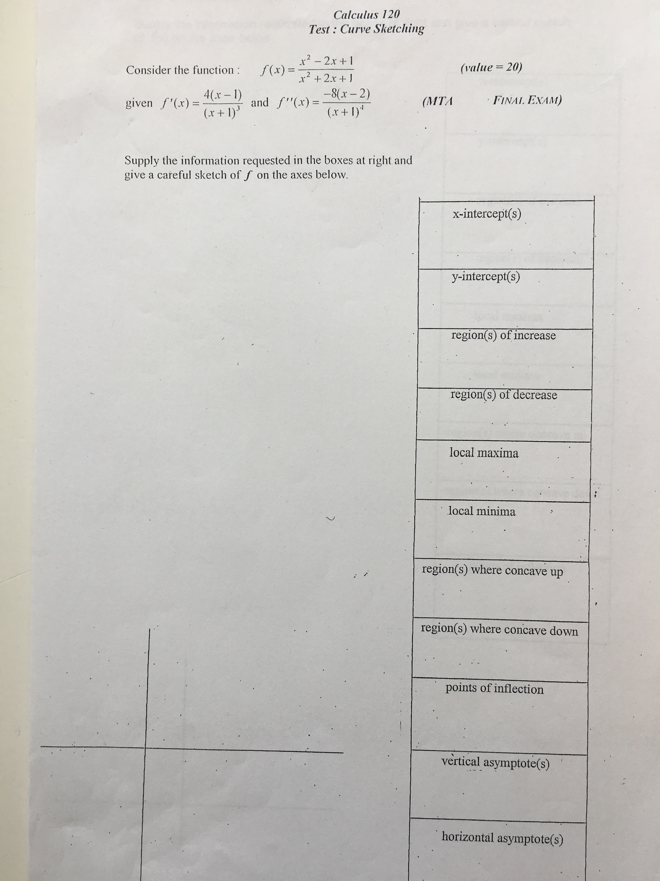

Slide 3
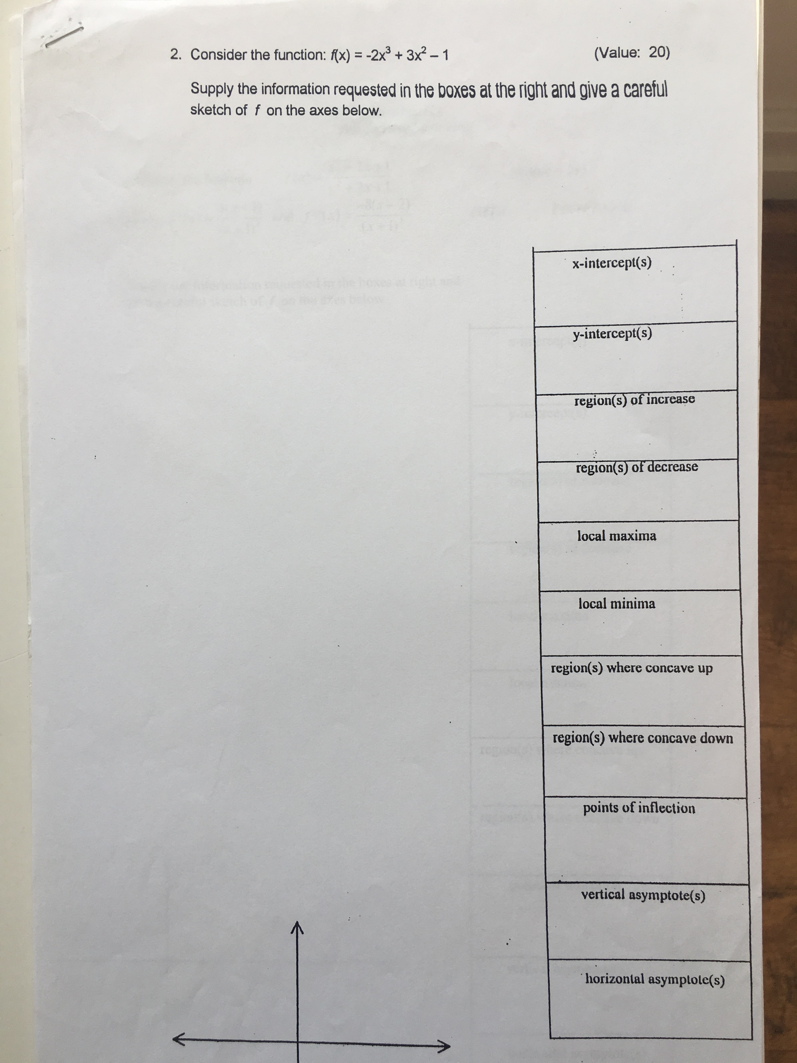

Slide 4
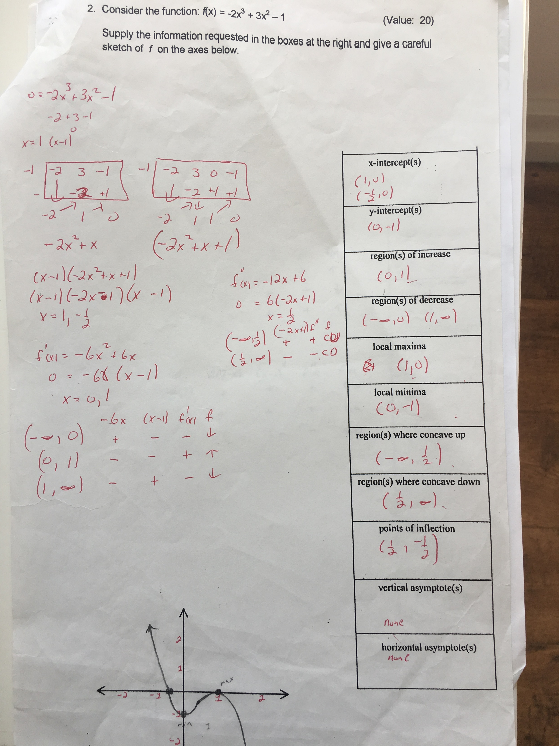

Slide 5
