Slide 1
Notes#4 Word problems using rational equations

Slide 2
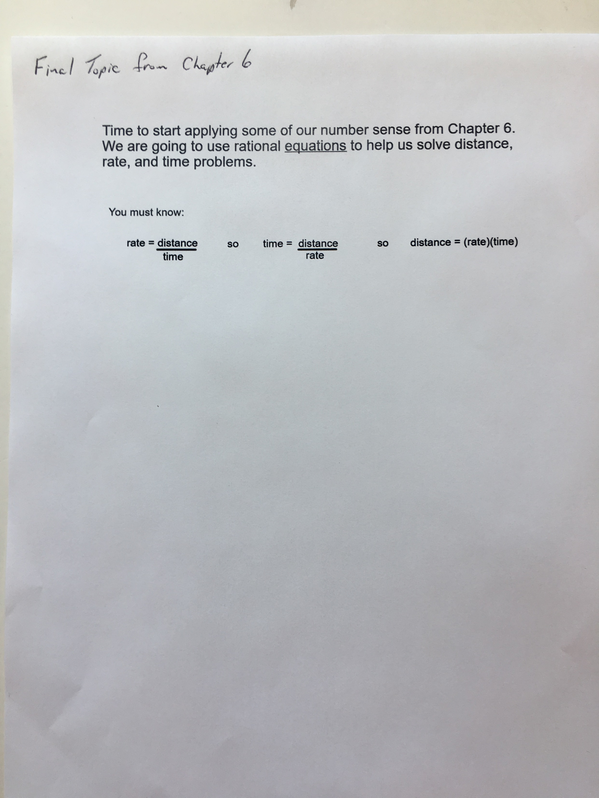

Slide 3
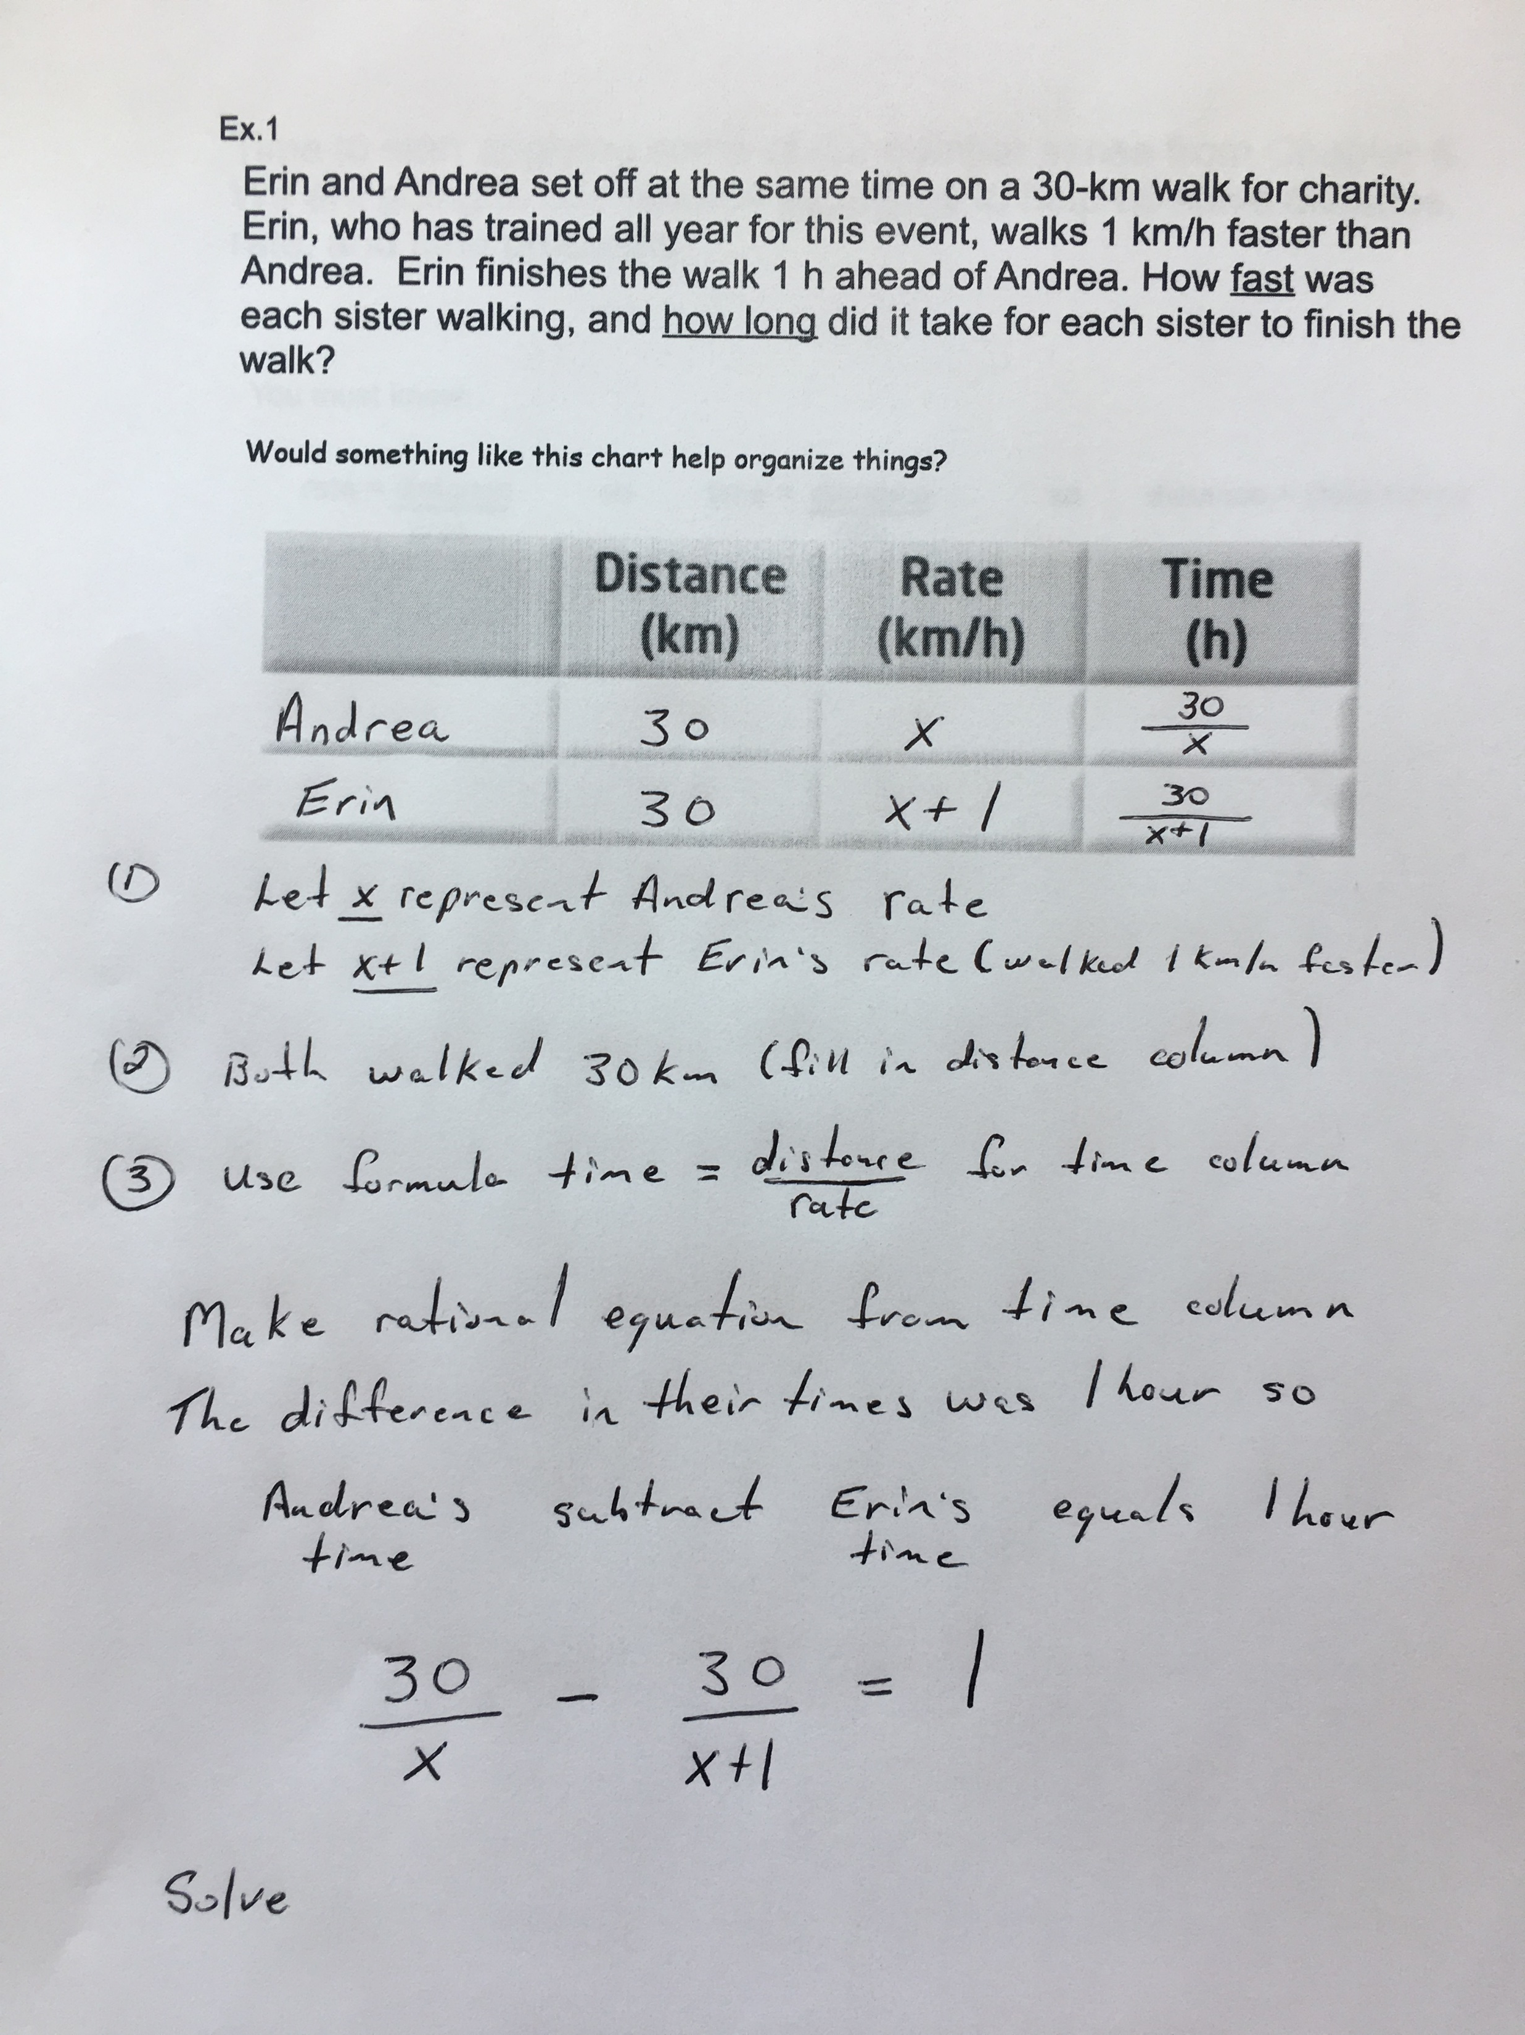

Slide 4
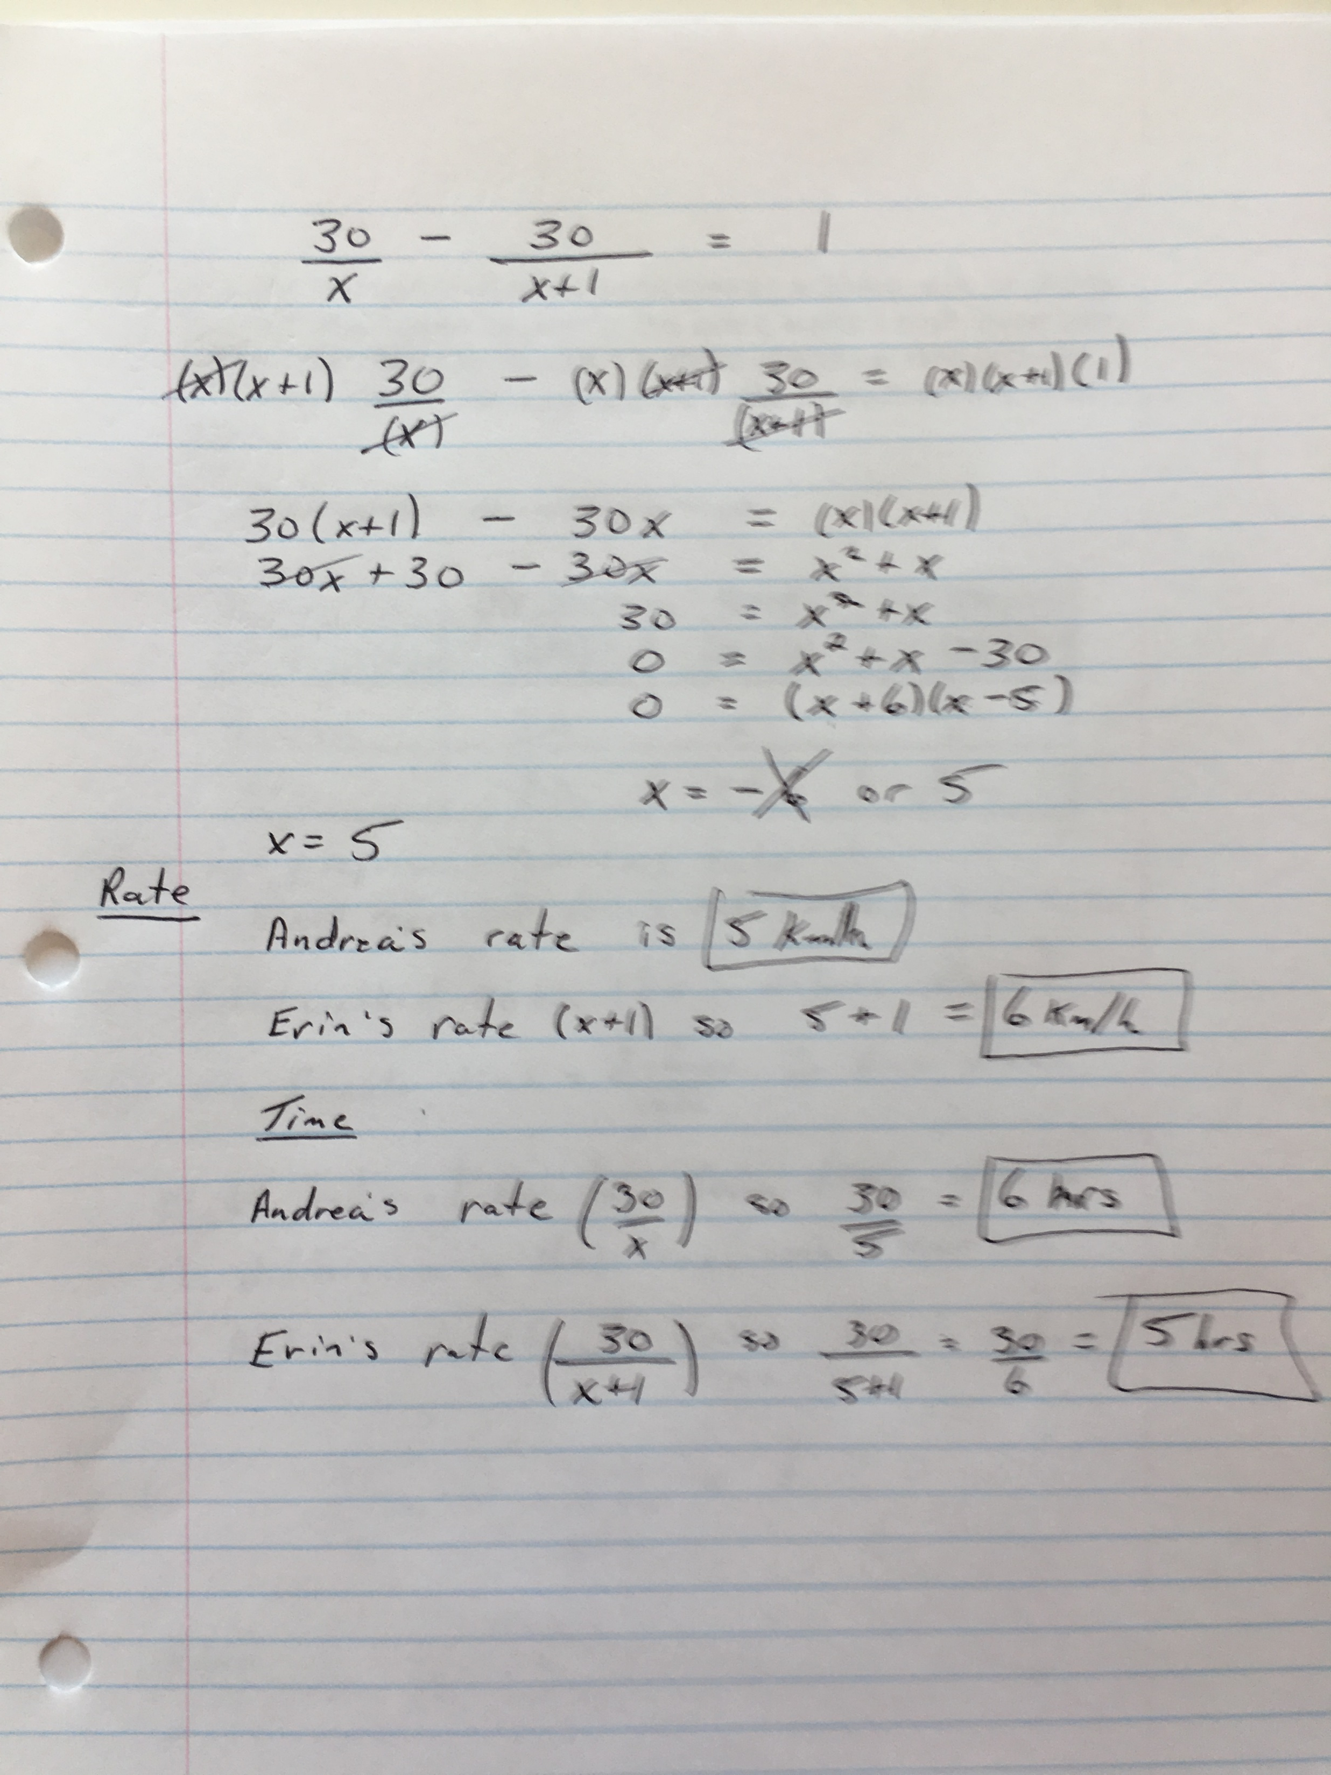

Slide 5
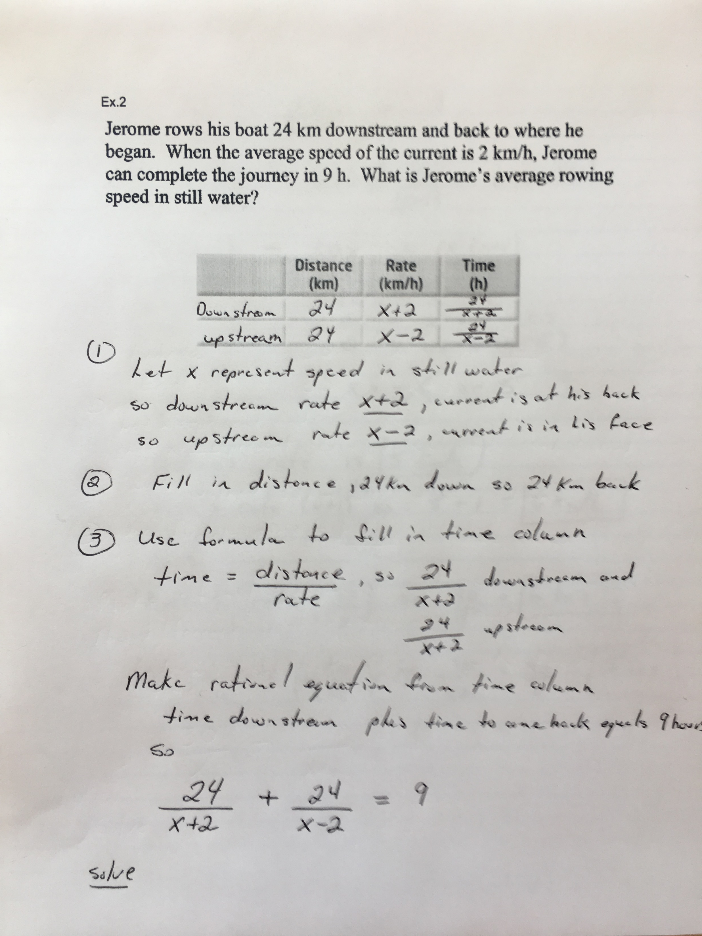

Slide 6
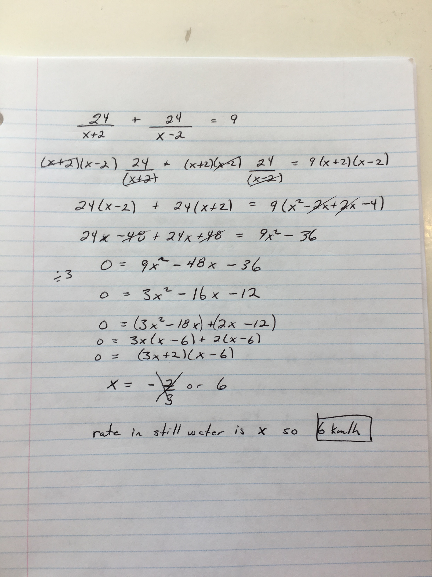

Slide 7
Practice Problems...
Pages 349 - 350
# 14, 16, 17, 18

